Slide 1
Ripple Tank System

Slide 2
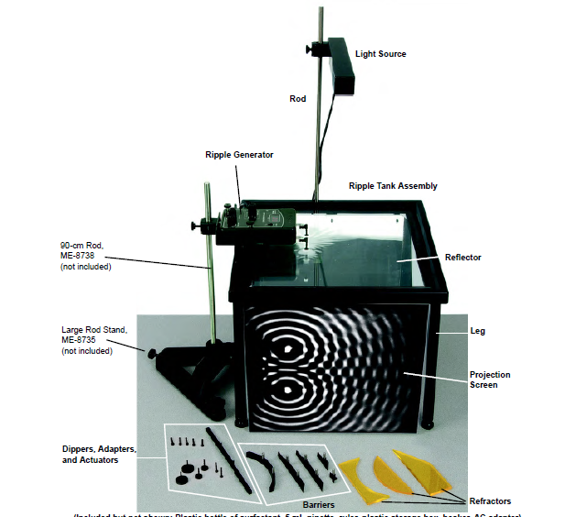

Slide 3
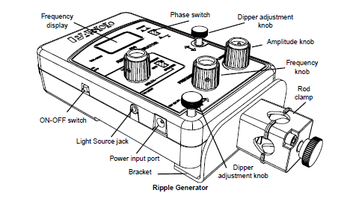

Slide 4
Light source
The Light Source can be used as a strobe or as a steady source.
Notes:
is a device used to produce regular flashes of light. It is one of a number of devices that can be used as a stroboscope. ... Larger strobe lights can be used in “continuous” mode, producing extremely intense illumination.

Slide 5
Dipper Adjustment
Two dipper adjustment knobs for making small changes to the height and orientation of the generator. You can make fine adjustments with these two knobs to position the dippers, without moving the entire ripple generator up or down on its rod.

Slide 6
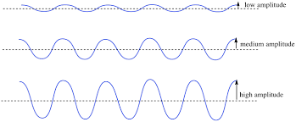
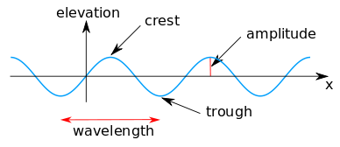
Amplitude Adjustment
The Amplitude knob adjusts the ripple arm amplitude.
As you turn the knob clockwise, the amplitude increases. Turning the knob counter-clockwise (right-to-left) decreases the amplitude

Slide 7
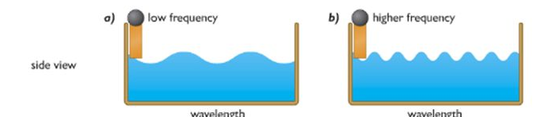
Frequency Adjustment
The Frequency knob adjusts the ripple arm frequency.
The range is from 1.0 to 50.0 Hz.
Default frequency is 20.0 Hz
Turn the knob clockwise to increase the frequency or counter-clockwise to decrease the frequency.

Slide 8
Refractors/ barriers used
Straight barrier
Curved barrier
Concave refractor
Convex refractor
Trapezoidal refractor

Slide 9
experiment
Reflection:
Study the reflection of plane waves from straight and curved barriers.
2. Refraction:
Study how plane waves bend when they pass from one medium to
another where the wave speed is different.

Slide 10
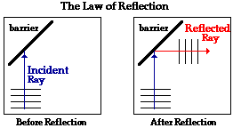
Reflection
Reflection, abrupt change in the direction of propagation of a wave that strikes the boundary between different mediums

Slide 11
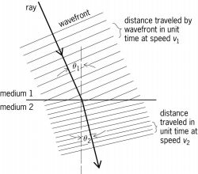
refraction
Refraction of waves involves a change in the direction of waves as they pass from one medium to another“

Slide 12
Wave speed
Wave speed is the distance a wave travels in a given amount of time, such as the number of meters it travels per second. Wave speed is related to wavelength and wave frequency by the equation:
Speed = Wavelength x Frequency.
v=f*λ

Slide 13
Experiment 1: Reflection
The purpose of this activity is to study the reflection of a plane wave from different
shaped barriers
Straight barrier
Curved barrier.

Slide 14
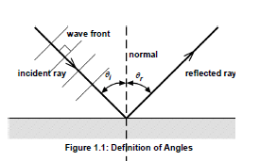
Straight barrier
A ray is a line that indicates the direction of motion of a plane wave. Wave fronts are perpendicular to the ray.
When a wave reflects from a surface, the angle of incidence is the angle between the incoming (or incident) ray and the normal (a line perpendicular to the surface). The angle of reflection is the angle between the outgoing (reflected) ray and the normal

Slide 15

Setup
1. Mount the light source onto its rod at the back edge of the
ripple tank.
2. Pour a small amount of water into the tank and adjust the feet on the legs of the tank to level the tank.
3. Place the long straight barrier in the middle of the tank and add about 800 mL of water to the tank (or enough water so that the water level is about halfway up the straight barrier.)
4. Use a rod and base to support the ripple generator and position the generator over the midpoint of one side of the ripple tank. Plug the light source into the ripple generator and connect the ripple generator to its power adapter.
5. Connect the plane wave dipper to the ripple arms. Adjust the ripple generator until the bottom of the plane wave dipper is barely in contact with the surface of the water.
6. Place a sheet of paper directly under the ripple tank so you will be able to sketch the images of the waves that are projected onto the sheet by the light source

Slide 16
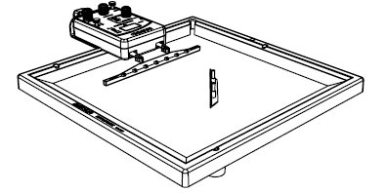
Procedure
Arrange the long barrier in the middle of the tank so the barrier is at an angle to the plane wave dipper (see Figure 1.2).
Turn on the ripple generator and the light source.
Set the ripple generator frequency to 20 Hz.
On the paper below the tank, place the ruler parallel to the plane waves that are incoming to the barrier. Make a line to show the incoming wave front.
Place the ruler parallel with a reflected wave and again make a line to show the outgoing(reflected) wave front.
Trace the position of the straight barrier.
Turn off the ripple generator and light source

Slide 17
Data Analysis
1. Draw a line that is perpendicular to the incoming wave front and extend the line to the outline of the straight barrier. This represents the incoming ray, so draw an arrow on it pointing to the barrier.
2. Draw a line from the point where the incoming ray intersects the straight barrier so it crosses the reflected wave front at a right angle. This represents the reflected ray, so draw an arrow on it pointing away from the barrier.
3. Draw the normal (perpendicular) line at the point of reflection on the outline of
the straight barrier.
4. Measure the angle of incidence and the angle of reflection and record the measurements
in the table.
5. Repeat the procedure with the barrier at a different angle.

Slide 18
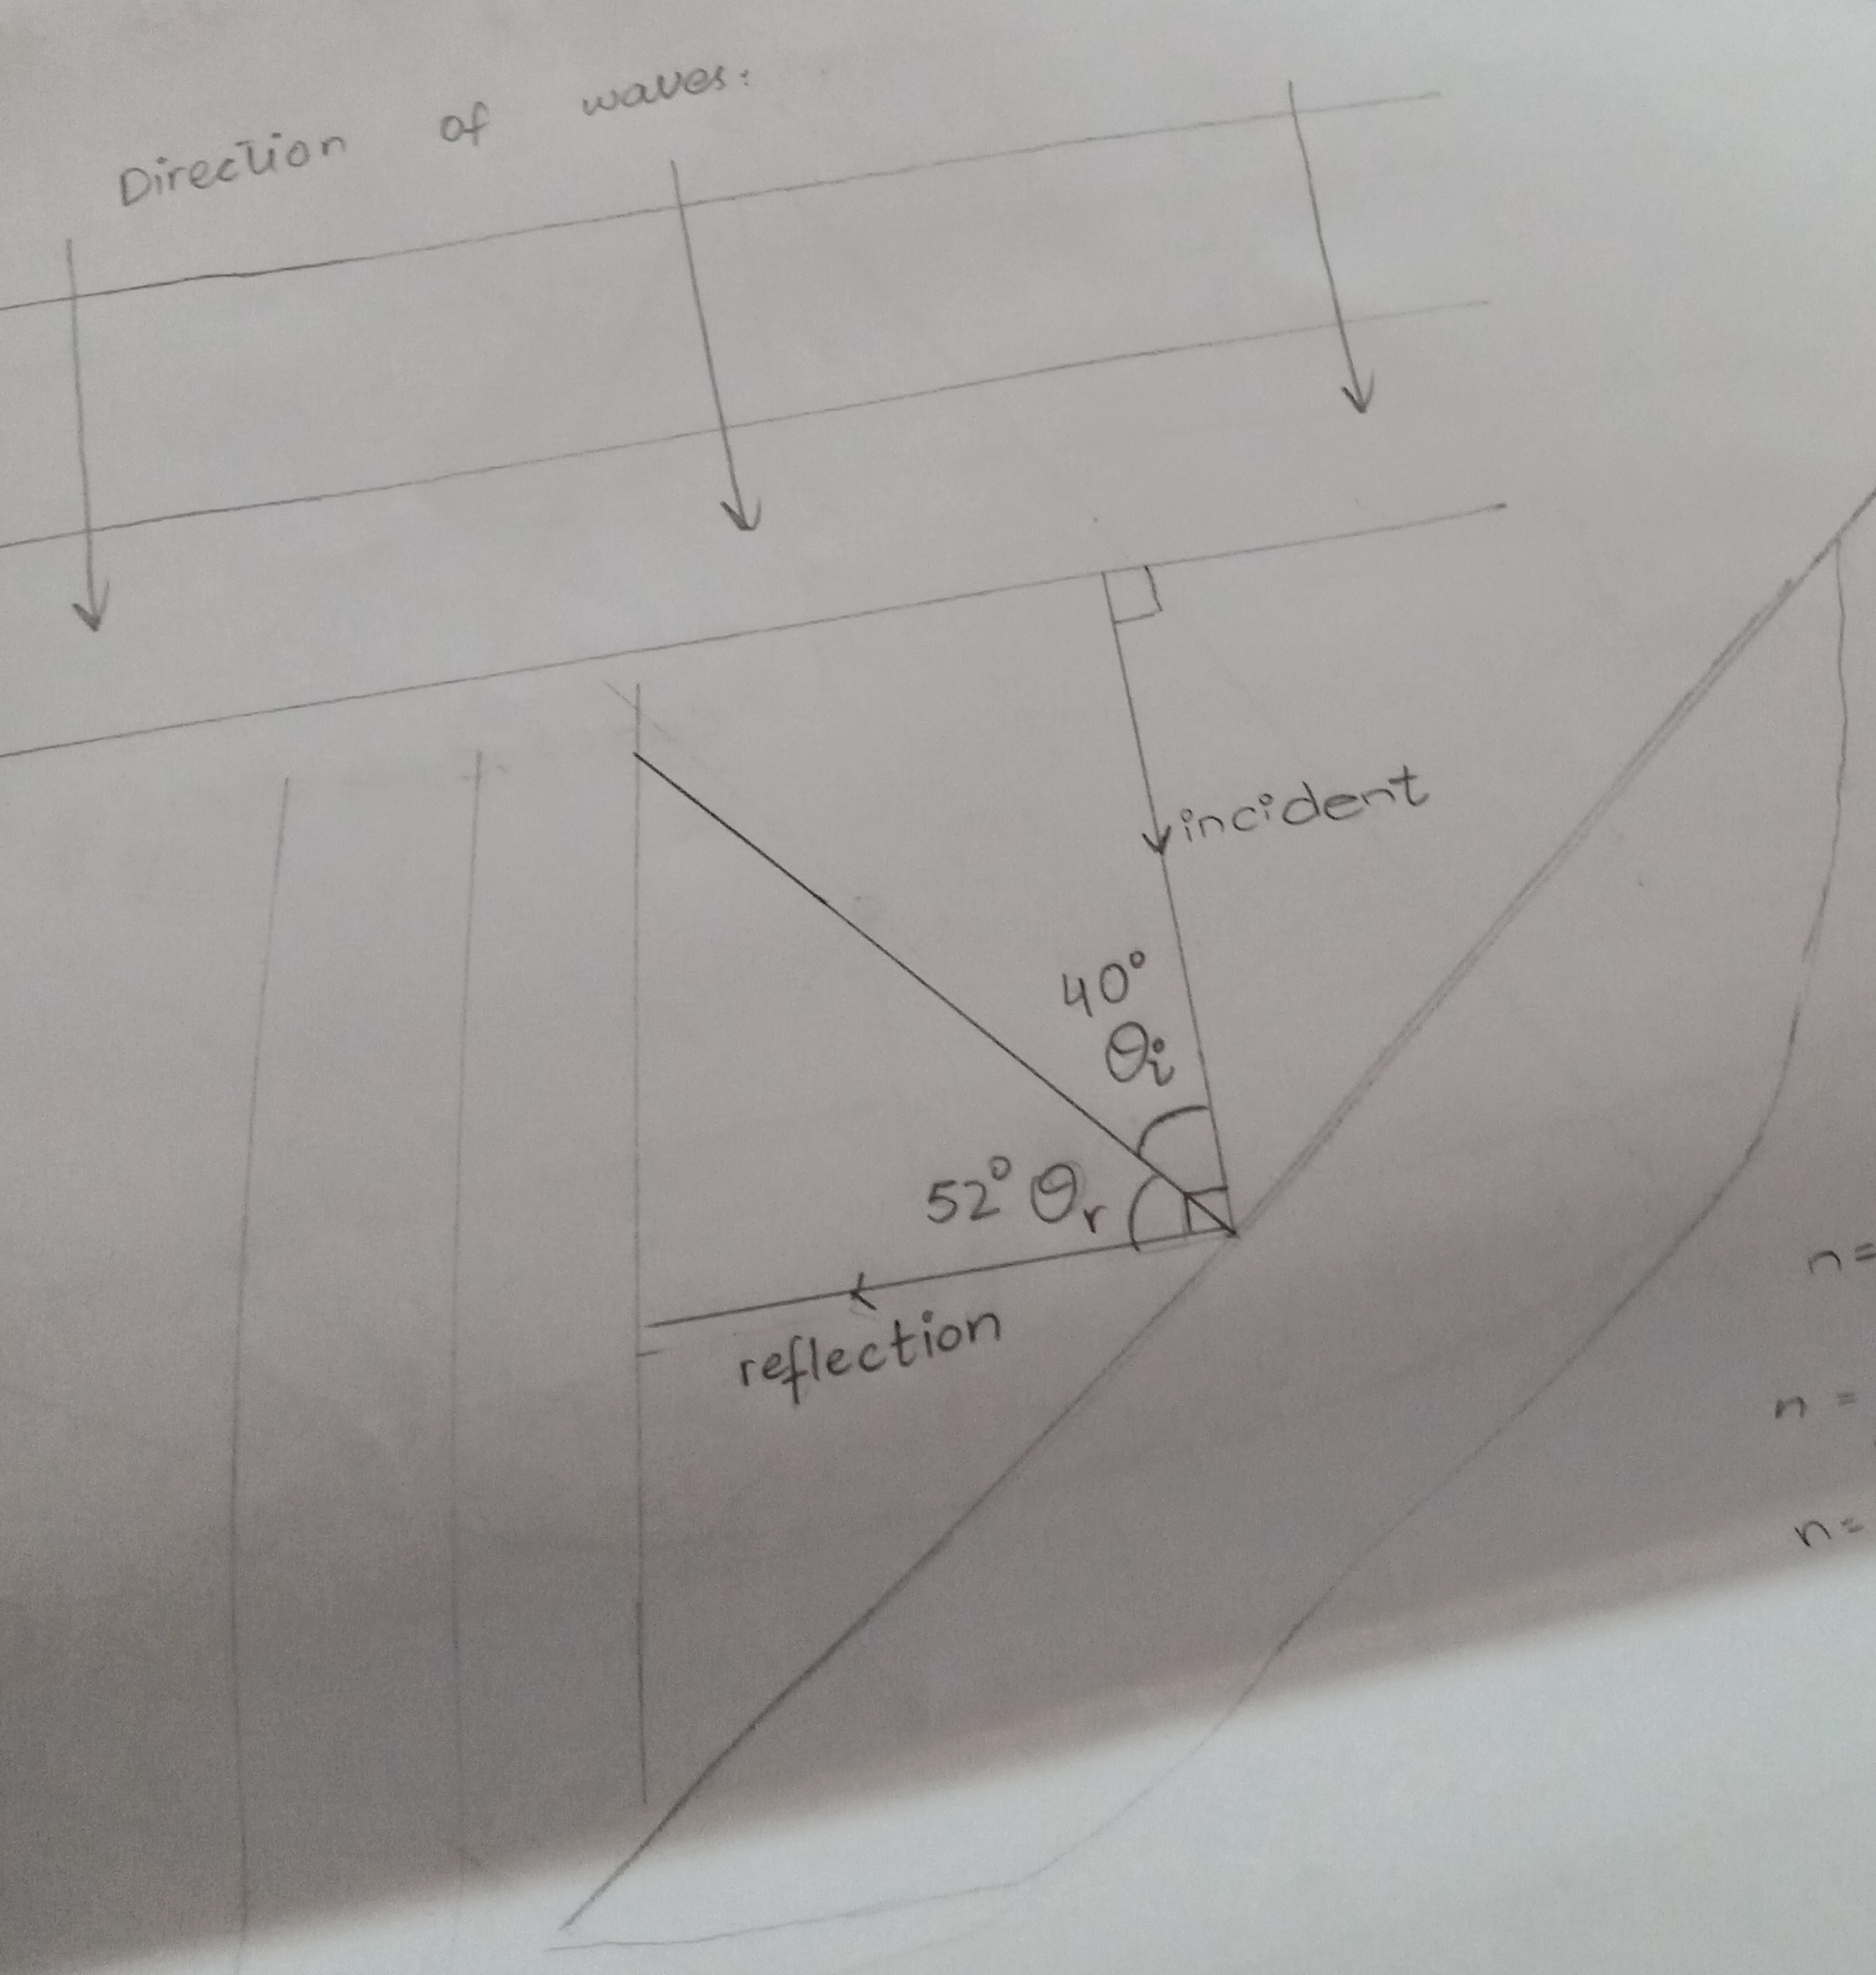
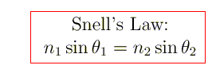
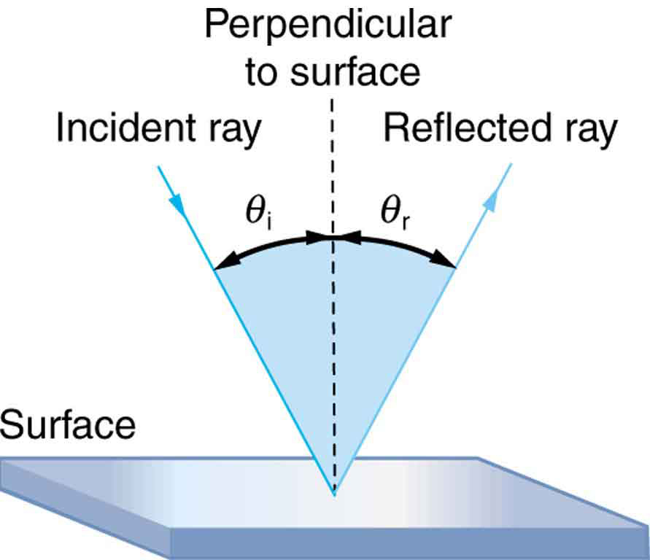

Slide 19
https://www.youtube.com/watch?v=qprevlYR9IQ

Slide 20
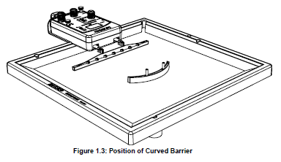
Reflection Using a Curved Barrier
Procedure
1.Replace the straight barrier with the curved barrier and position the curved barrier so it is aligned ‘parallel’ to the plane wave dipper as shown in Figure 1.3.
2. Turn on the light source. Trace the position of the curved barrier on the paper below the ripple tank.
3. Turn on the ripple generator.
4. Mark the position on the paper where the waves that reflect from the curved barrier appear to converge. Turn off the ripple generator.

Slide 21
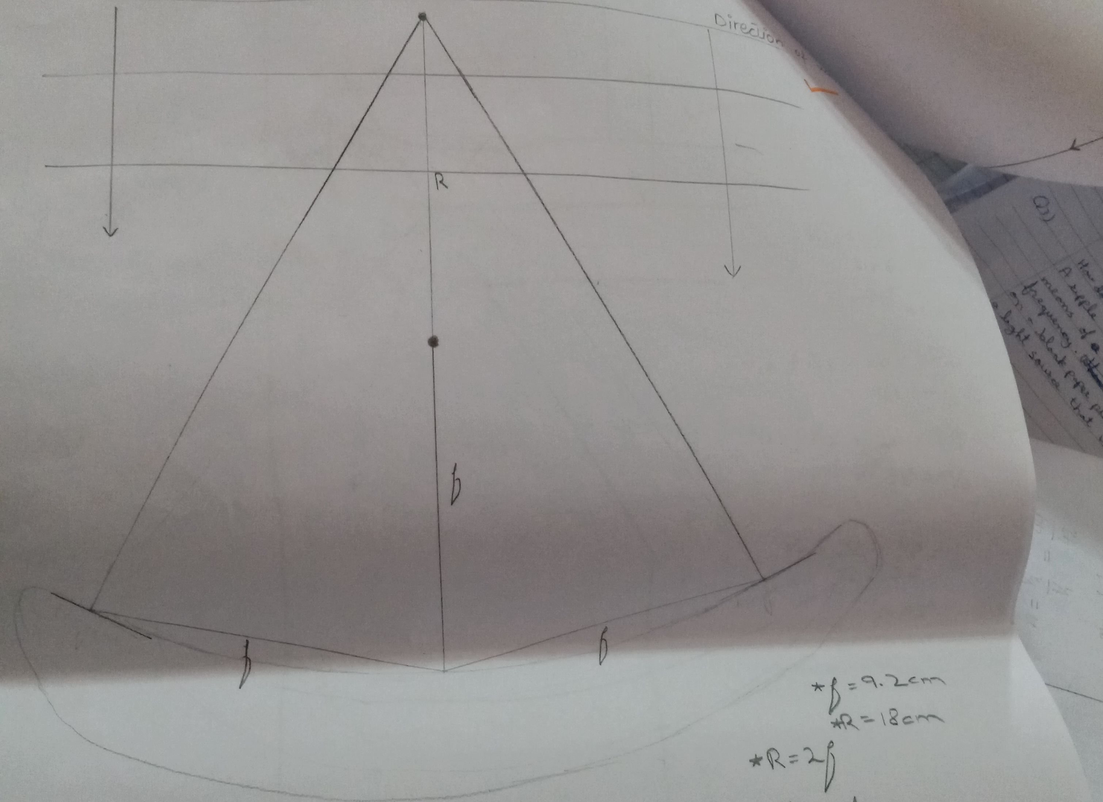

R=2f
R=radius of curvature
f=focal length
f=9.2cm R*=18cm
R=2f
R=2(9.2)=18.4
R*=18cm
Percentage error
=$\frac{18.4−18}{18.4} ∗100\%$
=2.2%
9.2cm

Slide 22
Refraction
The purpose of this activity is to show how waves change direction as they pass from
one region to another where the wave speed is different.

Slide 23
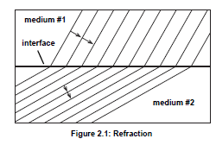
Refraction
As a wave travels from one medium to another where the wave
speed is different, the wave bends to a new direction. If the wave
slows down, the wave will bend toward the normal of the interface
between one medium and the other as shown in Figure 2.1. This
bending is called refraction.

Slide 24
Setup
1. Mount the light source onto its rod at the back edge of the ripple tank.
2. Pour a small amount of water into the tank and adjust the feet on the legs of the tank to level the tank.
3. Place the trapezoidal refractor in the middle of the tank and add about 700 mL of water, or enough water so that the water level is at the top edge of the refractor.
4. Use a rod and base to support the ripple generator and position the generator over the midpoint of one side of the ripple tank. Plug the light source into the ripple generator and connect the ripple generator to its power adapter.
5. Connect the plane wave dipper to the ripple arms. Adjust the ripple generator until the bottom of the plane wave dipper is barely in contact with the surface of the water.
6. Place a sheet of paper directly under the ripple tank so you will be able to sketch the images of the waves that are projected onto the sheet by the light source

Slide 25
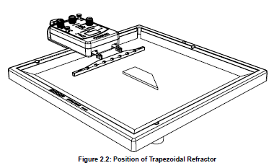

Slide 26
procedure
Arrange the trapezoidal refractor in the water in the middle of the tank so the rectangular end of the refractor is parallel to the plane wave dipper and about 5 cm from the dipper (see Figure 2.2).
2. Add just enough water to the tank so that the refractor is evenly covered by less than 1 mm of water.
3. Turn on the ripple generator and the light source . Set the ripple generator frequency to 15 Hz or less. adjust it as necessary to make a clear pattern of plane waves.
4. On the paper below the tank, trace the outline of the trapezoidal refractor.
5. Place the ruler parallel to the plane waves that are incoming to the refractor. Sketch lines to show the incoming wave fronts.
6. On the outline of the refractor, trace the shapes of the refracted waves to show the bending of the refracted waves as they travel over the refractor.
7. After sketching the waves, reverse the trapezoidal refractor so that the triangular end of the refractor points toward the plane wave dipper and repeat the procedure.
8. Turn off the ripple generator and light source.

Slide 27
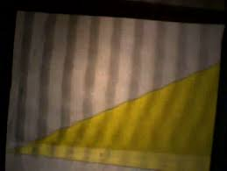
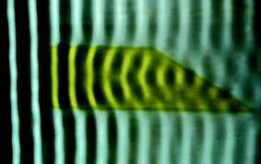
Refraction Using a trapezoidal refractor.

Slide 28
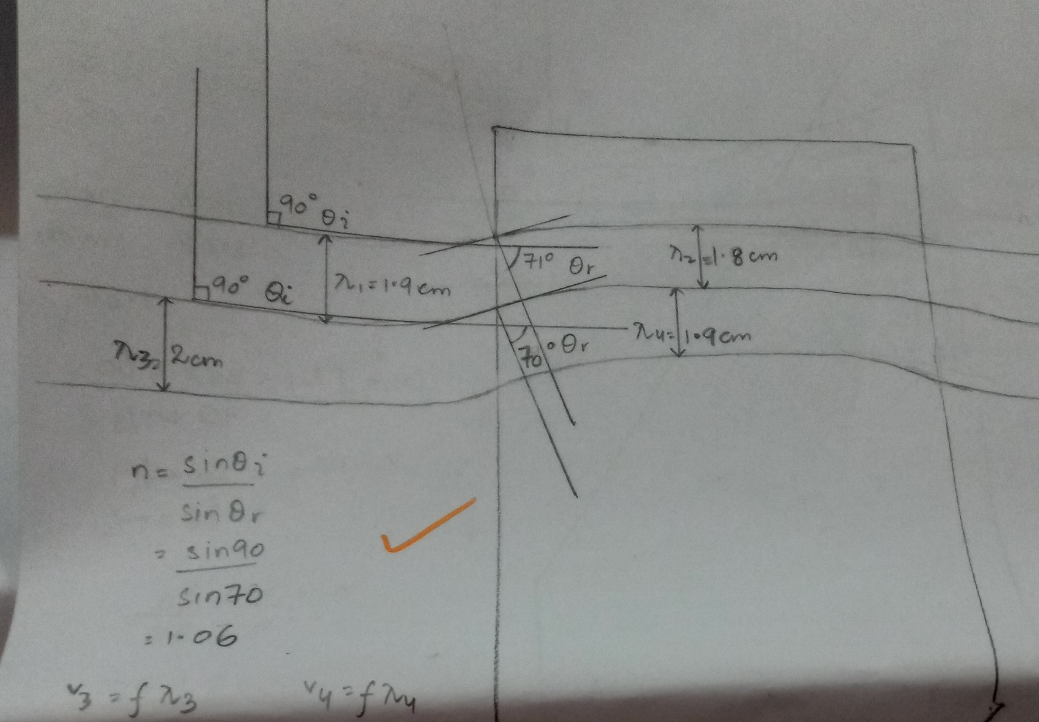
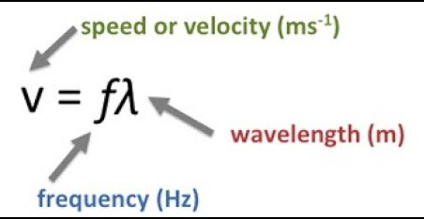





n=$\frac{\text{sin}\text{ϴ}\text{i}}{\text{sin}\text{ϴ}\text{r}}$
n=$\frac{\text{sin}\text{90}}{\text{si}\text{n}\text{70}}$=1.06
λ1=1.9m λ2=1.8cm
f=20Hz
v1=20*1.9= 38cm/s
v2= 20*1.8=36cm/s
n= $\frac{v1}{v2}$
= $\frac{38}{36}$
=1.05
Percentage error
=$\frac{1.06−1.05}{1.06} ∗100\%$
=0.75%

Slide 29
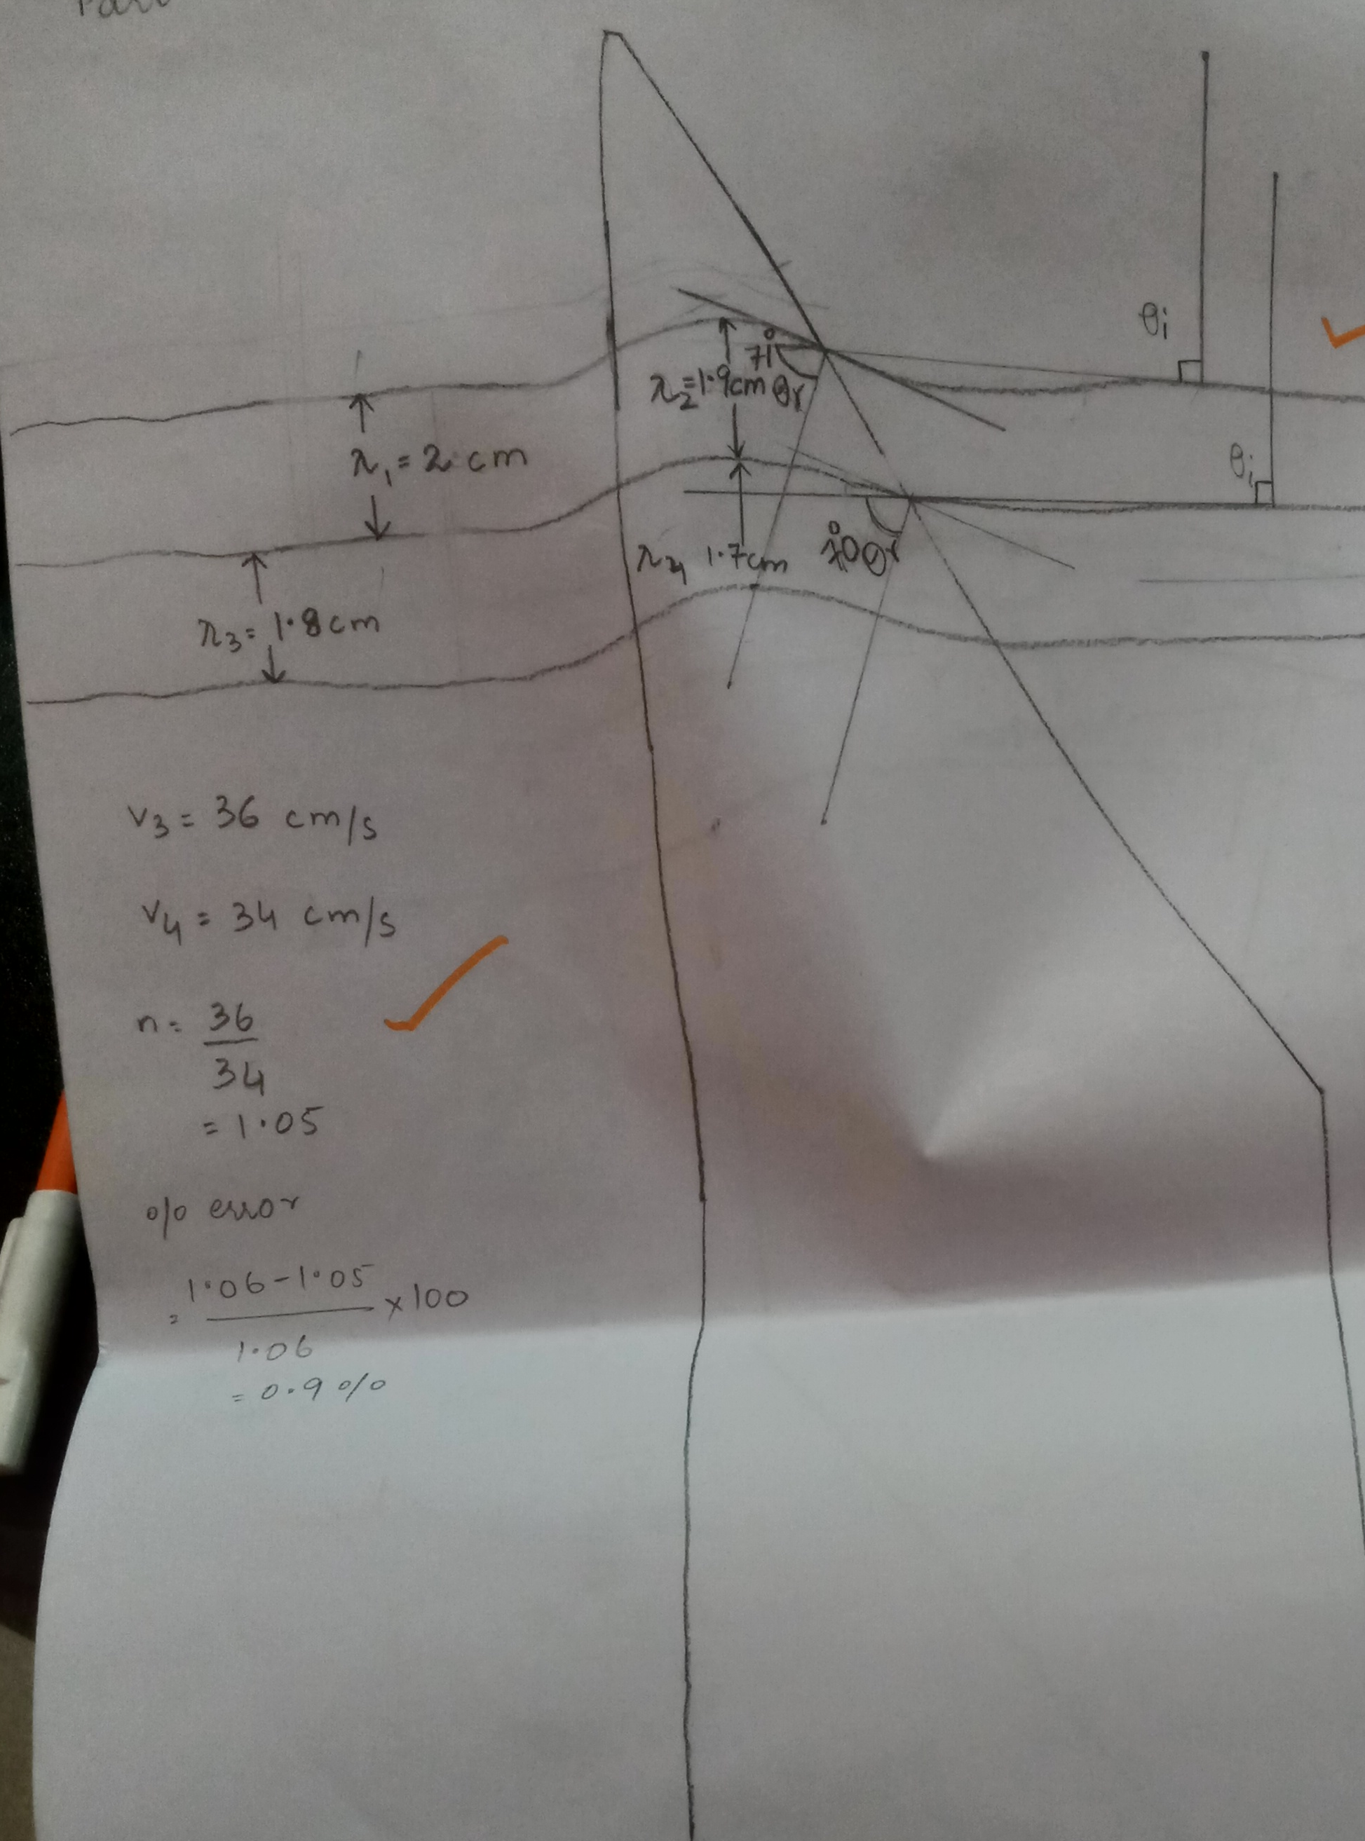




n=$\frac{\text{sin}\text{ϴ}\text{i}}{\text{sin}\text{ϴ}\text{r}}$
n=$\frac{\text{sin}\text{90}}{\text{s}in 71}$=1.05
λ1=2m λ2=1.9cm
f=20Hz
v1=2*20= 40cm/s
v2= 1.9*20=38cm/s
n= $\frac{v1}{v2}$
=1.05
Percentage error
=$\frac{1.05−1.05}{1.06} ∗100\%$
=0 %

Slide 30
Data Analysis
1. Draw a line that is perpendicular to the incoming wave front and extend the line
to the outline of the trapezoidal refractor. This represents the incoming ray, so
draw an arrow on it pointing to the refractor.
2. At the point where the line representing the incoming ray meets the outline of the
refractor, draw a new line that is perpendicular to the wave fronts of the refracted
waves as they pass over the trapezoidal refractor.

Slide 31
Refraction Using convex refractor Refractors
1. Use convex refractor now , placing it in the middle of the tank with the straight side parallel to the plane wave dipper and about 5 cm from the dipper as shown in Figure 2.3.
2. Turn on the ripple generator and light source. Trace the position of the convex refractor on the paper below the ripple tank.
3. Trace the pattern of plane waves as they move from the plane wave dipper over the convex refractor.

Slide 32
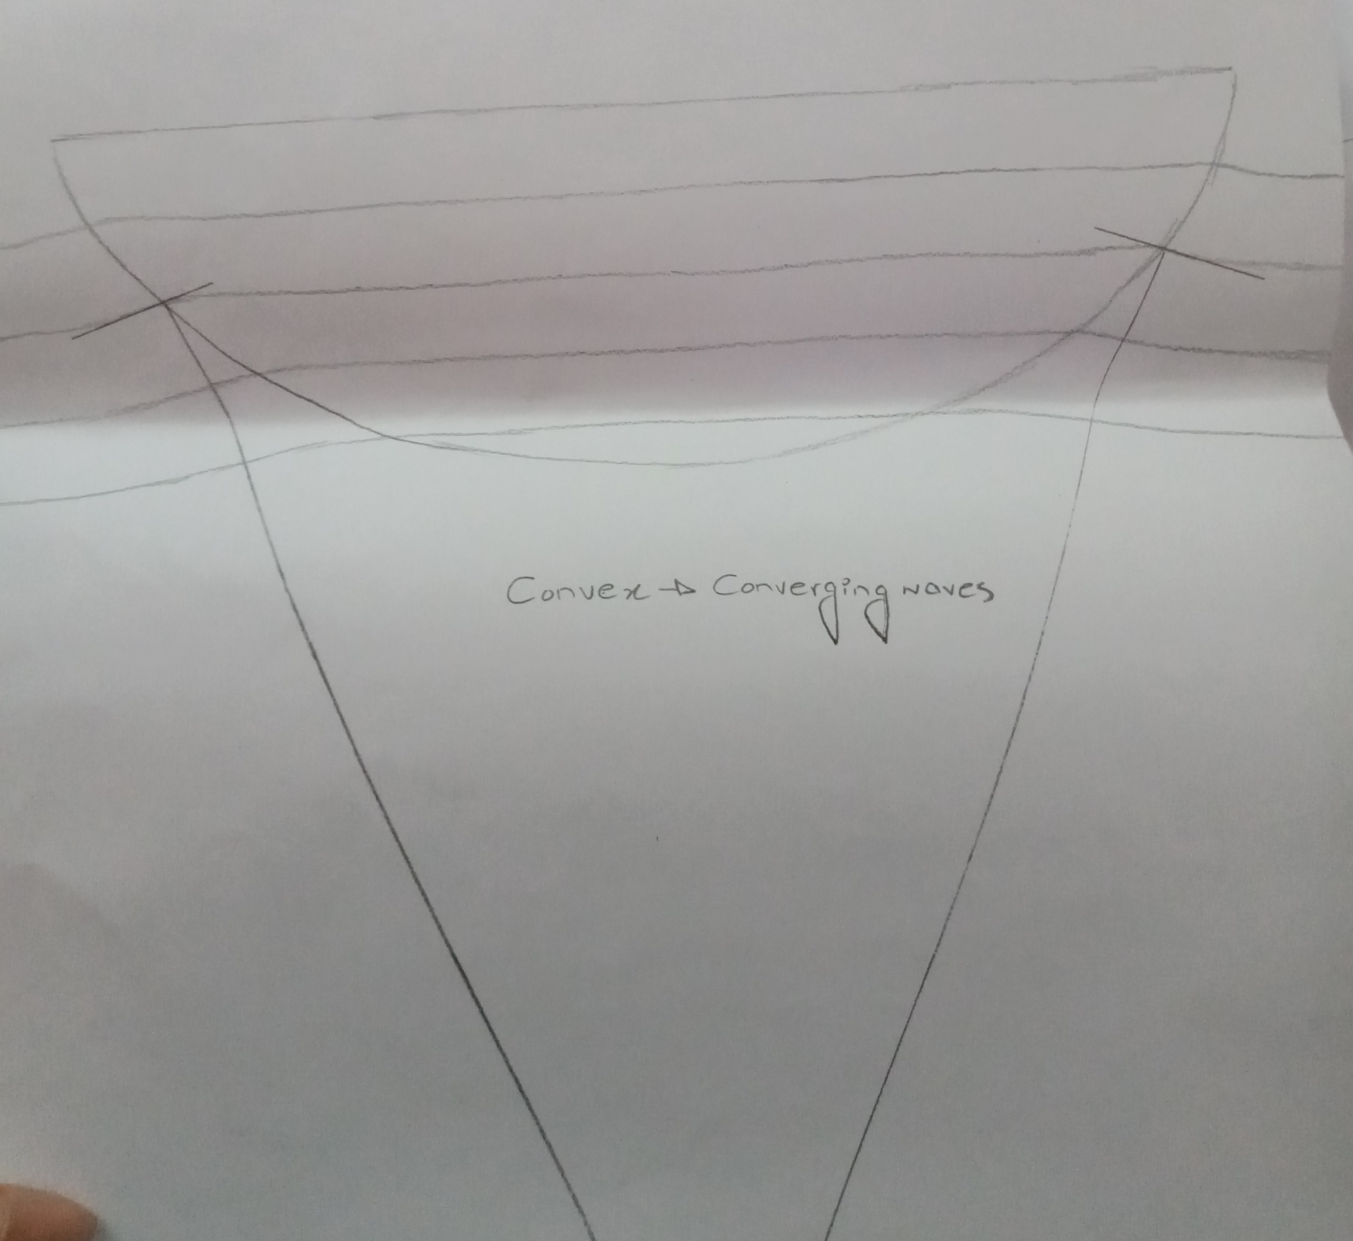
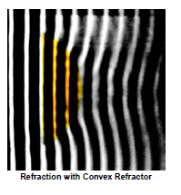

Slide 33
Refraction Using concave refractor Refractors
Use concave refractor now , placing it in the middle of the tank with the straight side parallel to the plane wave dipper and about 5 cm from the dipper
2. Turn on the ripple generator and light source. Trace the position of the convex refractor on the paper below the ripple tank.
3. Trace the pattern of plane waves as they move from the plane wave dipper over the concave refractor.

Slide 34
